Slide 1
ENHANCED BOTNET DETECTION IN IOT ENVIRONMENT USING STACKED DEEP LEARNING MODELS
Presented by
A. Aravind
RRN: 231272601001
M.Tech IT
Supervisor Dr. N. Rajendran
Associate Professor
Dept. of IT

Slide 2
CONTENTS
Objectives
Scope
Introduction
Literature Survey
Problem Identification
Proposed System
Architecture Diagram
Modules
Results
Conclusion
References

Slide 3
Objectives
To develop an enhanced botnet detection system for IoT environment using stacked deep learning model that combines Bidirectional Long Short-Term Memory and Custom DNN.

Slide 4
SCOPE
Enhanced models BiLSTM and DNNs can identify complex patterns in network traffic and offering high accuracy in detecting anomalies.
Aim at smart devices and environments, including smart homes, healthcare, and industry applications.

Slide 5
INTRODUCTION
The rapid proliferation of IoT devices has transformed various sectors, from healthcare to smart cities, but this growth has also heightened vulnerability to cyber threats and botnet attacks.
This project proposed an enhance botnet detection system utilizing a stacked deep learning model, combining Bidirectional Long Short-Term Memory and Custom DNN.
By leveraging established datasets this system aims to enhance the security of IoT network through near real-time detection and response.

Slide 6
LITERATURE SURVEY
AUTHOR | YEAR | TITLE | METHODOLOGY | ADVANTAGES | LIMITATION
Mudasir Ali, Mejdl Safran | 2024 | Sacked Machine Learning Model for Efficient Botnet Attack Detection in IoT Environment | Stacking Model: Artificial Neural Network (ANN), Convolutional Neural Network (CNN), Long Short-Term Memory (LSTM), and Recurrent Neural Network (RNN) to enhance prediction accuracy. | Superior Performance, Generalization Across Different Attacks | Long Training Time, Dependence on High-Quality Data
Harishkumar S, Bhuvaneshwaran R | 2024 | Enhanced DGA Detection in BotNet Traffic: Leveraging N-Gram, Topic Modeling, and BiLSTM | Domain Generation Algorithm (DGA) detection model for botnet traffic using a combines : N-Gram Analysis , Topic Modeling , BiLSTM (Bidirectional Long Short-Term Memory) | Attention Mechanism, Efficient Feature Extraction | Overfitting Data Dependency

Slide 7
LITERATURE SURVEY
AUTHOR | YEAR | TITLE | METHODOLOGY | ADVANTAGES | LIMITATION
James Jin Kang, Jumana Abu-Khalaf | 2024 | MalBoT-DRL: Malware Botnet Detection Using Deep Reinforcement Learning in IoT Networks | Deep Reinforcement Learning (DRL): Utilizes Q-learning and Deep Neural Networks (DNN) to detect botnet activity. | End-to-End Lifecycle Detection, Adaptive Learning, Efficient Resource Usage, | Limited Scope of Evaluation, Model Drift Over Time, Challenges with Malware
Muhammad Dany Alfikri, Rafael Kaliski | 2023 | Lightweight Meta-Learning BotNet Attack Detection | Meta-Learning Ensemble Models: The study proposes combining weak classifiers like Random Forest, Naive Bayes, and Decision Trees | Small and Medium dataset, Deployable on Edge Devices | Dataset Dependency, Challenges with Multiclass Classification

Slide 8
LITERATURE SURVEY
AUTHOR | YEAR | TITLE | METHODOLOGY | ADVANTAGES | LIMITATION
Fatma Taher, Mohamed Elhoseny | 2023 | Reliable Machine Learning Model for IoT Botnet Detection | Filter-based Fisher score to rank features by their relevance within each cluster. Wrapper-based Grasshopper Optimization Algorithm (GOA) to further refine the selected features. | sacked Optimization Approach, Improved Feature Selection | Complexity in Implementation, Dataset-Specific Performance, Limited Real-Time Evaluation
Fadwa Alrowais , Majdy M. Eltahir , Radwa Marzouk | 2023 | Modeling of Botnet Detection Using Chaotic Binary Pelican Optimization Algorithm With DL on IoT Environment | Botnet Detection using the Chaotic Binary Pelican Optimization Algorithm with Deep Learning (BNT-CBPOADL) for IoT security | Effective Deep Learning Mode, Robust Hyper parameter Tuning, Efficient Feature Selection | Potential Overfitting, Data Dependency, Computational Complexity

Slide 9
LITERATURE SURVEY
AUTHOR | YEAR | TITLE | METHODOLOGY | ADVANTAGES | LIMITATION
Jawad Ahmad , Sultan Almakdi | 2024 | A Lightweight CNN-LSTM sacked Model With Learnable Skip Connections for Efficient Botnet Attack Detection in IoT | The proposed model, SkipGateNet, is a lightweight sacked deep learning model that integrates CNN and LSTM layers with learnable skip connections | Fast Inference: Requires only 8 milliseconds, Lightweight & Efficient: Model size is 2596.87 KB | Limited to Specific Attacks
Sven Nõmm , Hayretdin Bahsi | 2022 | In-Depth Feature Selection for the Statistical Machine Learning-Based Botnet Detection in IoT Networks | Feature selection for statistical machine learning-based botnet detection in IoT networks. | Feature Selection Approaches: (Filter Method, Wrapper Method), | Dataset Comparison : N-BaIoT (attack phase), MedBIoT (C&C and post-attack phases)

Slide 10
PROBLEMS IN EXISTING SYSTEM
The literature survey lacks direct comparative performance analysis of existing methods in terms of accuracy and latency.
It overlooks scalability aspects, leaving uncertainty about model efficiency in large-scale IoT deployments.
Additionally, there is limited discussion on real-time detection capabilities and practical deployment.
Although federated learning is proposed in the current project for secure and decentralized training, it is missing from the reviewed works.
Finally, most surveyed models rely on specific datasets, raising concerns about generalizability to novel or unseen botnet attacks.

Slide 11
Proposed solution
The system for botnet attack detection utilizes a Stacked Deep Learning Model combine:
DNN-BiLSTM model is designed to leverage DNN’s ability to extract complex patterns
BiLSTM sequential learning capability for detecting botnet attacks.
The trained model is combined into a Streamlit web framework, allowing users to upload IoT network traffic data and obtain real-time predictions on detect the traffic is normal or an attack

Slide 12
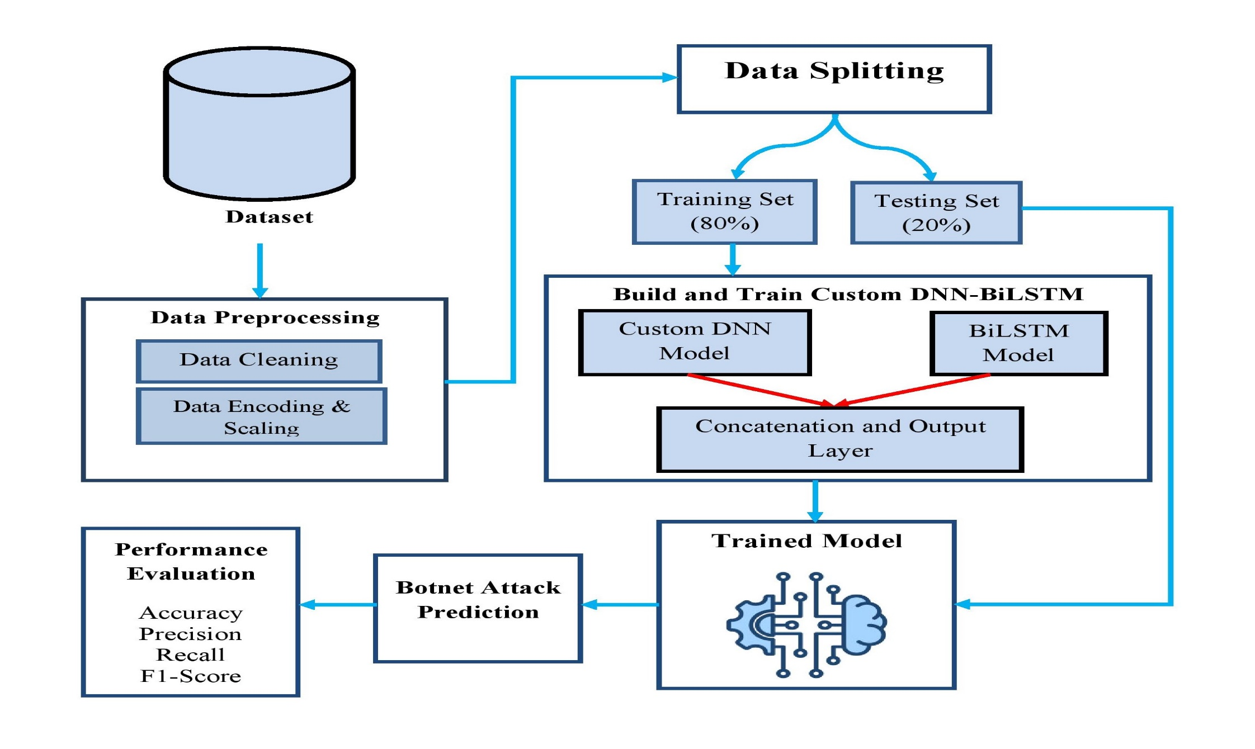
ARCHITECTURE diagram

Slide 13
LIST OF MODULES
Data Collection and Preprocessing
Model Building
Model Training
Botnet Detection
Reporting

Slide 14
MODULE DESCRIPTION
Data Collection and Preprocessing:
The Kaggle IoT traffic dataset includes labelled records of normal and attack instances with features like source/destination addresses, protocol types, packet sizes, and timestamps.
Pre-processing Steps:
Data Cleaning: Removed redundant and irrelevant fields (e.g., IPs, timestamps, packet IDs).
Label Encoding: Converted categorical attributes (e.g., protocols, flags) to numeric using a pre-trained label encoder.
Input Representation
Let the input feature vector for each sample be:
x∈R^{n}
After reshaping for time series (with 1-time step for each sample):
X∈R^{1×n}

Slide 15
MODULE DESCRIPTION
Model Building:
The DNN component consists of a series of fully connected dense layers with progressively decreasing neuron counts: 512, 256, 128, 64, and 32 neurons. Each dense layer is followed by a Dropout layer with a rate of 0.3 to mitigate overfitting and enhance generalization.
This path applies multiple dense layers with ReLU activations and dropout:
Let: h0=X
Then each layer is defined recursively as:
h₁ = ReLU(W₁h_{o}+b₁), h₁ Dropout (h₁, p = 0.3)
h₂ = ReLU(W₂h₁+b₂), h₂ Dropout (h₂, p = 0.3)
………
h₅ =ReLU (W₅h₄ + b₅) ∈ R³²

Slide 16
MODULE DESCRIPTION
Model Building:
Bidirectional LSTM (BiLSTM): the BiLSTM network is employed to learn temporal and sequential characteristics by processing input data in both forward and backward directions through time
Bidirectional LSTM Path
For the same input X, Bi-LSTM computes forward and backward hidden states:
Let: h = LSTM_{Fwd}(X)
h = LSTM_{Bwd}(X)
Then concatenate:
h_{bilstm} = [h; h] ∈ R^{2d}
This is followed by:
Z₁ = ReLU (W₆h_{bilstm} + b₆)
Z₂ = ReLU (W₇Z₁ + b₇) ∈ R³²

Slide 17
MODULE DESCRIPTION
Model Training:
The stacked DNN-BiLSTM model is trained using the pre-processed dataset with the following training parameters:
Batch Size: 25 (to balance computational efficiency and model performance)
chosen for its ability to dynamically adjust learning rates, ensuring efficient and stable training. During training, the model learns network traffic patterns by minimizing loss and adjusting weights to improve classification accuracy.
concatenated Layer
The DNN and Bi-LSTM are concatenated:
f= [h₅​; Z₂​] ∈R⁶⁴
Final output layer (binary classification with sigmoid):
ŷ = σ (W^{T} f + b) ∈ [0, 1]

Slide 18
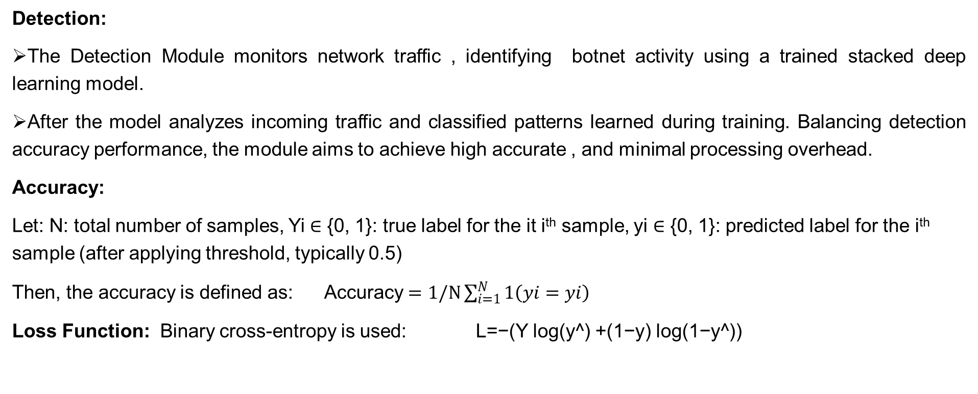
MODULE DESCRIPTION
Detection:
The Detection Module monitors network traffic , identifying botnet activity using a trained stacked deep learning model.
After the model analyzes incoming traffic and classified patterns learned during training. Balancing detection accuracy performance, the module aims to achieve high accurate , and minimal processing overhead.
Accuracy:
Let: N: total number of samples, Yi ∈ {0, 1}: true label for the it i^{th} sample, yi ∈ {0, 1}: predicted label for the i^{th} sample (after applying threshold, typically 0.5)
Then, the accuracy is defined as: Accuracy $=1/N\sum_{i=1}^{N}{1\left(yi=yi\right)}$
Loss Function: Binary cross-entropy is used: L=−(Y log(y^​) +(1−y) log(1−y^​))

Slide 19
MODULE DESCRIPTION
Reporting Module:
The reporting module generates detailed reports on detected threats and system performance, offering insights for analysis and system improvement.
It compiles data from the detection modules, including metrics like detected botnet attacks, attack types, affected devices, detection times, false positive rates, detection latency, and resource usage.
This module ensures continuous evaluation and refinement of the botnet detection system.

Slide 20
RESULTS
The proposed stacked DNN-BiLSTM model effectively detects botnet attacks in IoT traffic, model resulted in a 1.93% improvement in detection accuracy compared to baseline approaches, achieving 98.91% accuracy and a ROC AUC of 0.9894.
High precision, recall, and F1-scores for both normal and attack traffic indicate balanced and reliable performance, with minimal false positives and negatives.

Slide 21
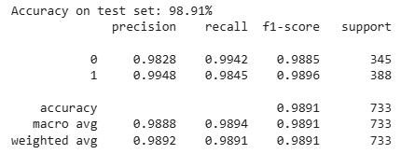
SCREENSHOTS
Performance Metrics:

Slide 22
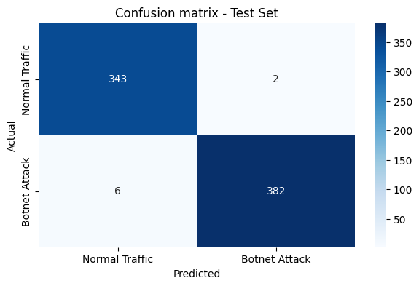
SCREENSHOTS
Confusion Matrix:

Slide 23
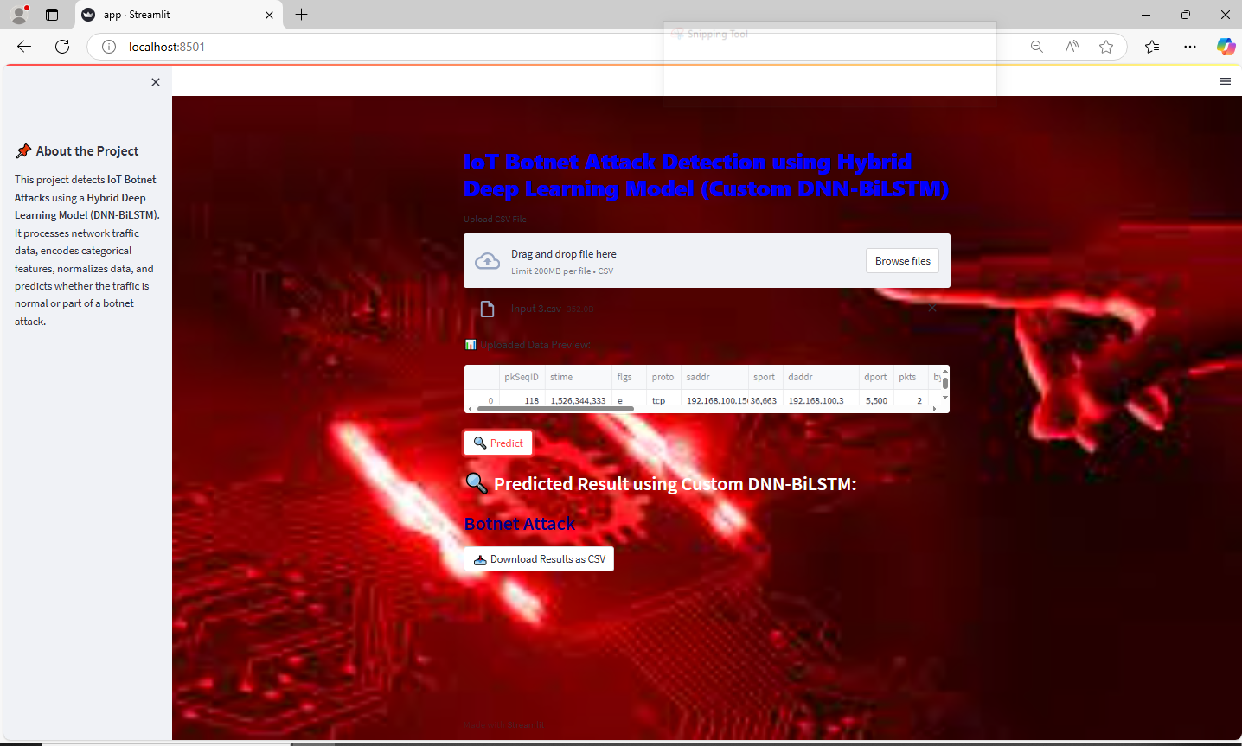
SCREENSHOTS
Web Interface Attack Detection:

Slide 24
CONCLUSION AND FUTUREWRK
This project developed a stacked DNN-BiLSTM model for IoT botnet detection, achieving 98.91% accuracy and enabling near real-time detection through a Streamlit web interface for practical and user-friendly deployment.
Future enhancements can include improving model generalization for unseen attacks, integrating federated learning for decentralized and privacy-preserving training, and optimizing model efficiency for support large-scale real-time applications.

Slide 25
SOFTWARE & HARDWARE Requirements
Software Requirements:
Operating system: Windows 10.
Coding Language: Python
Platform: Google Colab
Web Framework: Streamlit
Hardware Requirements:
System: Core i5 Processor.
Hard Disk: 500 GB.
Ram : 4 GB

Slide 26
REFERENCES
M. Ali, M. Shahroz, M. F. Mushtaq, S. Alfarhood, M. Safran and I. Ashraf, "Stacked Machine Learning Model for Efficient Botnet Attack Detection in IoT Environment," in IEEE Access, vol. 12, pp. 40682-40699, 2024.
M. Al-Fawa’reh, J. Abu-Khalaf, P. Szewczyk and J. J. Kang, "MalBoT-DRL: Malware Botnet Detection Using Deep Reinforcement Learning in IoT Networks," in IEEE Internet of Things Journal, vol. 11, no. 6, pp. 9610-9629, 15 March15, 2024.
F. Taher, M. Abdel-Salam, M. Elhoseny and I. M. El-Hasnony, "Reliable Machine Learning Model for IIoT Botnet Detection," in IEEE Access, vol. 11, pp. 49319-49336, 2023.
M. S. Alshehri, J. Ahmad, S. Almakdi, M. A. Qathrady, Y. Y. Ghadi and W. J. Buchanan, "SkipGateNet: A Lightweight CNN-LSTM Stacked Model with Learnable Skip Connections for Efficient Botnet Attack Detection in IoT," in IEEE Access, vol. 12, pp. 35521-35538, 2024.

Slide 27
REFERENCES
R. Kalakoti, S. Nõmm and H. Bahsi, "In-Depth Feature Selection for the Statistical Machine Learning-Based Botnet Detection in IoT Networks," in IEEE Access, vol. 10, pp. 94518-94535, 2022.
D. Arnold, M. Gromov and J. Saniie, "Network Traffic Visualization Coupled with Convolutional Neural Networks for Enhanced IoT Botnet Detection," in IEEE Access, vol. 12, pp. 73547-73560, 2024.
M. Lefoane, I. Ghafir, S. Kabir, I. -U. Awan, K. El Hindi and A. Mahendran, "Latent Semantic Analysis and Graph Theory for Alert Correlation: A Proposed Approach for IoT Botnet Detection," in IEEE Open Journal of the Communications Society, vol. 5, pp. 3904-3919, 2024.
S. A. Abdulkareem, C. Heng Foh, M. Shojafar, F. Carrez and K. Moessner, "Network Intrusion Detection: An IoT and Non IoT-Related Survey," in IEEE Access, vol. 12, pp. 147167-147191, 2024.

Slide 28
THANK YOU

